Slide 1
Itility Machine Learning Hackathon
Kobe Bryant – Which shots did he sink?
1.0 by DKOO
January 16, 2019

Slide 2
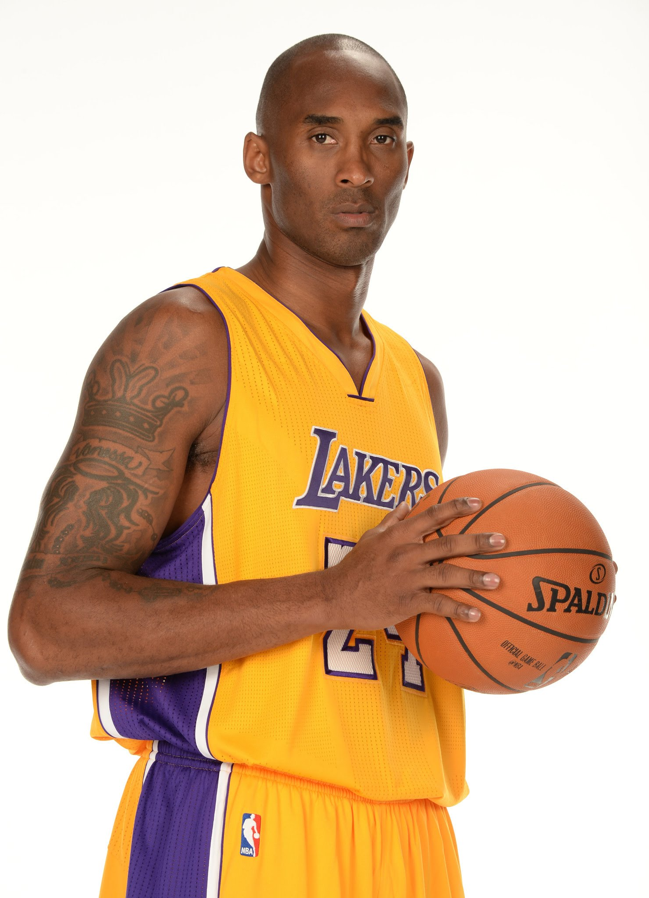
The Case
Data from Kobe Bryant’s 20-year career:
Every single field-goal attempt (±30.000);
Many metrics about the shot (25);
(Including it being a hit or miss)
4.500 Hit/Miss values are NA
Lets see if we can predict the hits and misses;
And give Kobe some advice on how to improve ☺

Slide 3
The Data
You will receive 3 files;
This presentation
A data.csv file
You have to split the rows with NA hit/miss variable into train / test sets
A sample_submission.csv file
Since the NA’s are random, the shot ID’s aren’t consecutive!
shot_id | shot_made_flag
15 | 0,5
18 | 0,5
21 | 0,5
24 | 0,5
26 | 0,5
29 | 0,5
31 | 0,5
34 | 0,5
54 | 0,5
56 | 0,5
64 | 0,5
65 | 0,5

Slide 4
The Data
The dataset contains the following variables:
action_type
combined_shot_type
game_event_id
game_id
lat
loc_x
loc_y
lon
minutes_remaining
period
playoffs
season
seconds_remaining
shot_distance
shot_made_flag ← Target Variable
shot_type
shot_zone_area
shot_zone_basic
shot_zone_range
team_id
team_name
game_date
matchup
opponent
shot_id ← Row label

Slide 5
The Data
Keep in mind;
Set contain categorical, numeric, binary and time variables
This is a binary classification problem
Data leakage is obviously possible, please play fair!!

Slide 6
The Goals
Classify hit or miss probability
1 = Hit
0 = Miss
Play Kobe’s coach for 1 minute, giving him advice on how to improve his game

Slide 7
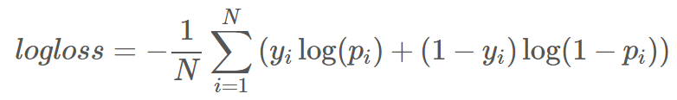

The scoring
Scoring will be done by calculating Log-Loss:
Range 0 - ∞, where a perfect score is 0;
Log-loss provides extreme punishments for being both confident and wrong;
Meaning predicting a 1 that should’ve been 0 results in an infinite error!!
Thus ONLY give probabilities (0 < prediction < 1)
For calculating log-loss, LN / $\log_{e}{ }$is used, not $\log_{10}{ }$!!
Your coaching capabilities will be judged by Marianne

Slide 8
The scoring
Benchmarks
Only 0,5’s → Log-Loss of 0,69315
0,1 < Random Value < 0,9 → Log-Loss of ± 1
Winner is one of the top 3 teams with the best advice for Kobe!

Slide 9
The solutions
Mail solutions to daniel.koops@itility.nl
Include:
Only the solutions file;
Presentation can be given with own laptop, no need to mail
Please mind the following before sending!:
Only 2 columns needed in solutions csv file:
Shot ID (shot_id)
Hit / Miss (shot_made_flag)
Submit all 4500 predictions;
Use a semicolon (;) as separator, and a comma (,) as decimal separator (makes my life easier ☺);

